Slide 1
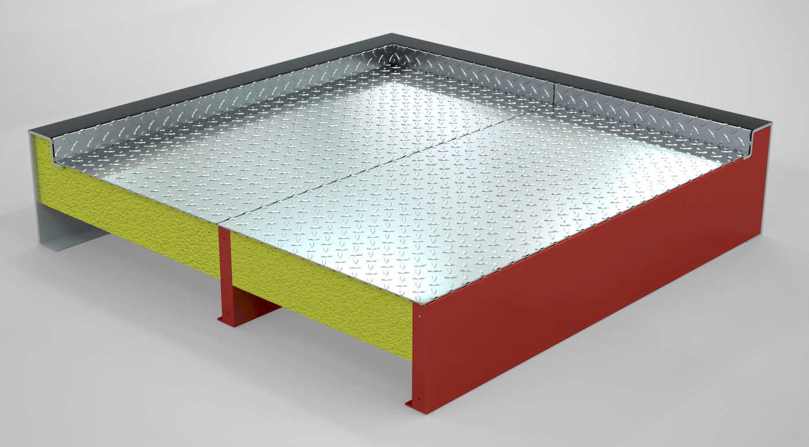
Introducing…our newest casing innovation
High Strength Base (HSB)
Same Strength, Less Metal
Upgraded Thermal Performance with continuous thermal break
Easier multi-piece field assembly
up to 17% increase in moment of inertia
38% increase in yield strength
12.5% increase in ultimate tensile strength
Available with structural members
steel, stainless steel or aluminum

